Slide 1
Multi-user mimo-ofdm modem

Slide 2
CONTENT
Architecture of 802.11n PHY layer
Low Density Parity Check Codes
Sum Product Algorithm
TGn MIMO Channel
Channel Estimation & Equalisation
Packet Detection
Simulator and MIMO Modes
Architecture of 802.11ac PHY layer
MU MIMO and massive MIMO
Conclusion

Slide 3
IEEE 802.11n
The demands for the wireless connections in high data rates has led development of Wireless Local Area Network (WLAN) technology.
WLAN caters to the high-density demand with higher throughput and speed than the cellular network.
IEEE 802.11 provides specifications for implementation of the WLAN. It is concerned with the Physical and the Media Access Control layer of the communication link.
802.11n is an amendment to the 802.11 series with the amendment in 2009 being the most popular one.
A major change in Wi-Fi came with the 802.11n as it brought MIMO keeping the legacy support.

Slide 4
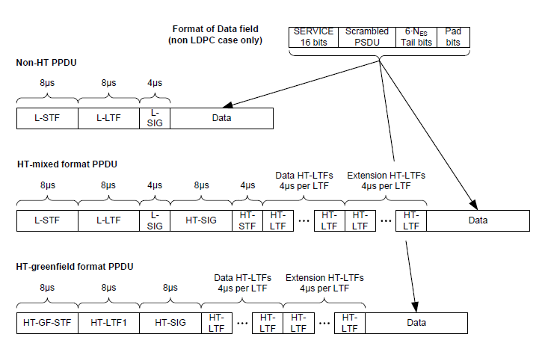
Physical layer frame format

Slide 5
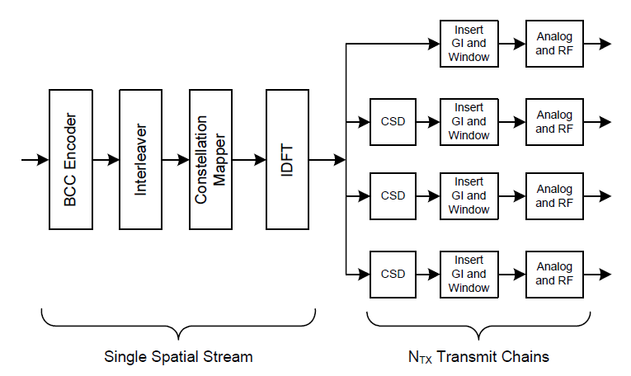
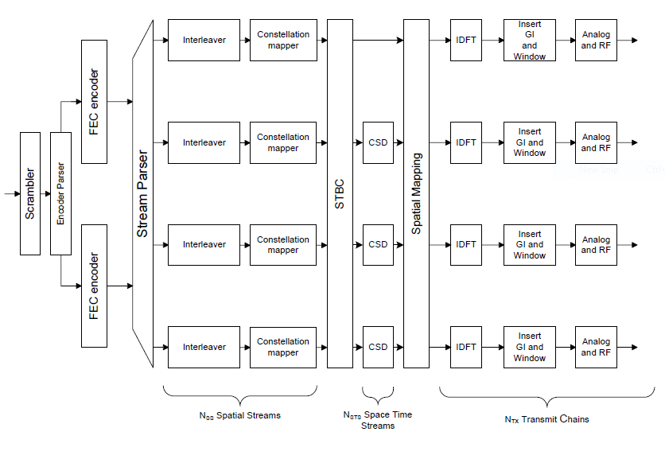
802.11n PHY layer architecture

Slide 6
SS, STS and transmit chain
Spatial Stream: It refers to the number of data streams that have to be modulation using constellation mapper. Essentially N_{SS} spatial streams mean an increment of N_{SS} times in the data rate.
Space Time Stream: It refers to the number of spatial streams on which Alamouti scheme has been applied. So, if N_{STBC} spatial stream undergoes Alamouti scheme, then we have N_{SS} = N_{STS} + N_{STBC}.
Transmit Chain: The transmit chain refers to the number of antennae that will be used to transmit space time streams. A precoder matrix is used to map the space time stream on transmit chains.

Slide 7
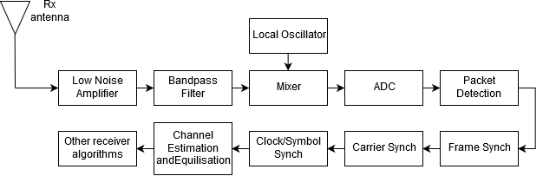
RECEIVER ARCHITECTURE

Slide 8
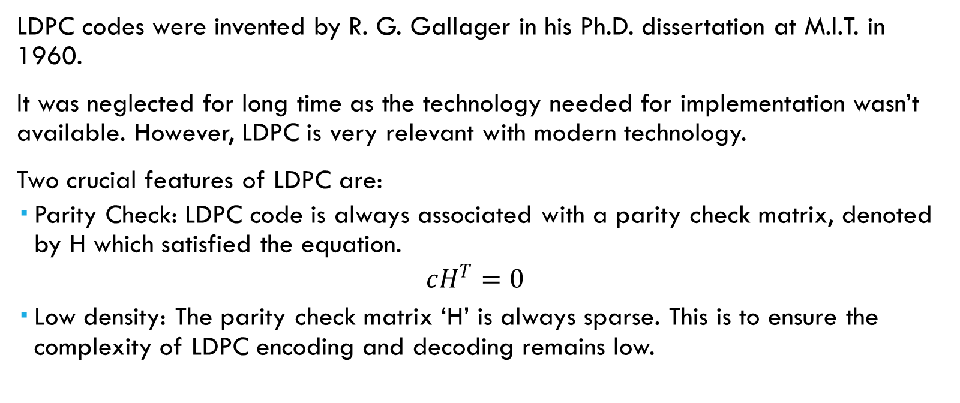
Low Density Parity Check codes
LDPC codes were invented by R. G. Gallager in his Ph.D. dissertation at M.I.T. in 1960.
It was neglected for long time as the technology needed for implementation wasn’t available. However, LDPC is very relevant with modern technology.
Two crucial features of LDPC are:
Parity Check: LDPC code is always associated with a parity check matrix, denoted by H which satisfied the equation.
$$cH^{T}=0$$
Low density: The parity check matrix ‘H’ is always sparse. This is to ensure the complexity of LDPC encoding and decoding remains low.

Slide 9
Tanner graph
LDPC codes can also be represented by a bipartite Tanner graph, which was proposed by Tanner in 1981.
The Tanner graph consists of two sets of vertices:
n vertices for the codeword bits (also called variable nodes)
r vertices for the parity-check equations (called check nodes).
An edge joins a variable node to a check node if that bit is included in the corresponding parity-check equation.
The number of edges in the Tanner graph is equal to the number of ones in the parity-check matrix.

Slide 10
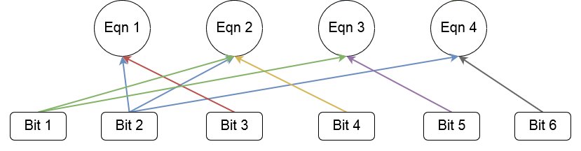
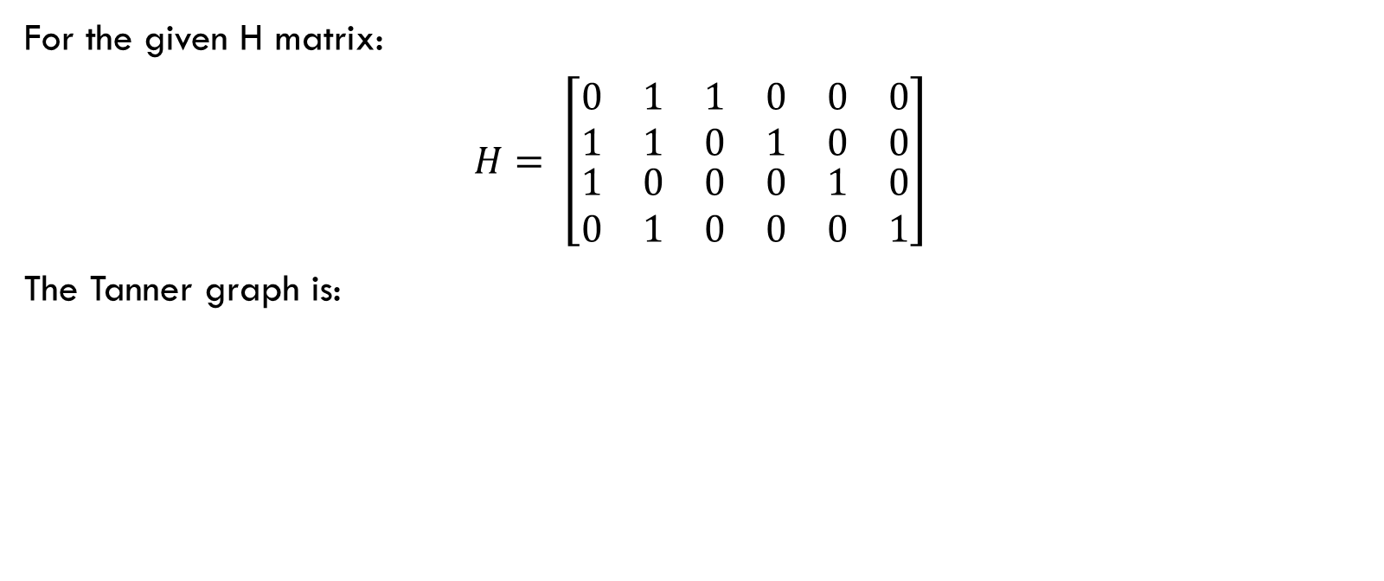
Tanner graph
For the given H matrix:
$H= \left[\begin{matrix}\begin{matrix}0 & 1 & 1 \\ 1 & 1 & 0\end{matrix} & \begin{matrix}0 & 0 & 0 \\ 1 & 0 & 0\end{matrix} \\ \begin{matrix}1 & 0 & 0 \\ 0 & 1 & 0\end{matrix} & \begin{matrix}0 & 1 & 0 \\ 0 & 0 & 1\end{matrix}\end{matrix}\right]$
The Tanner graph is:

Slide 11
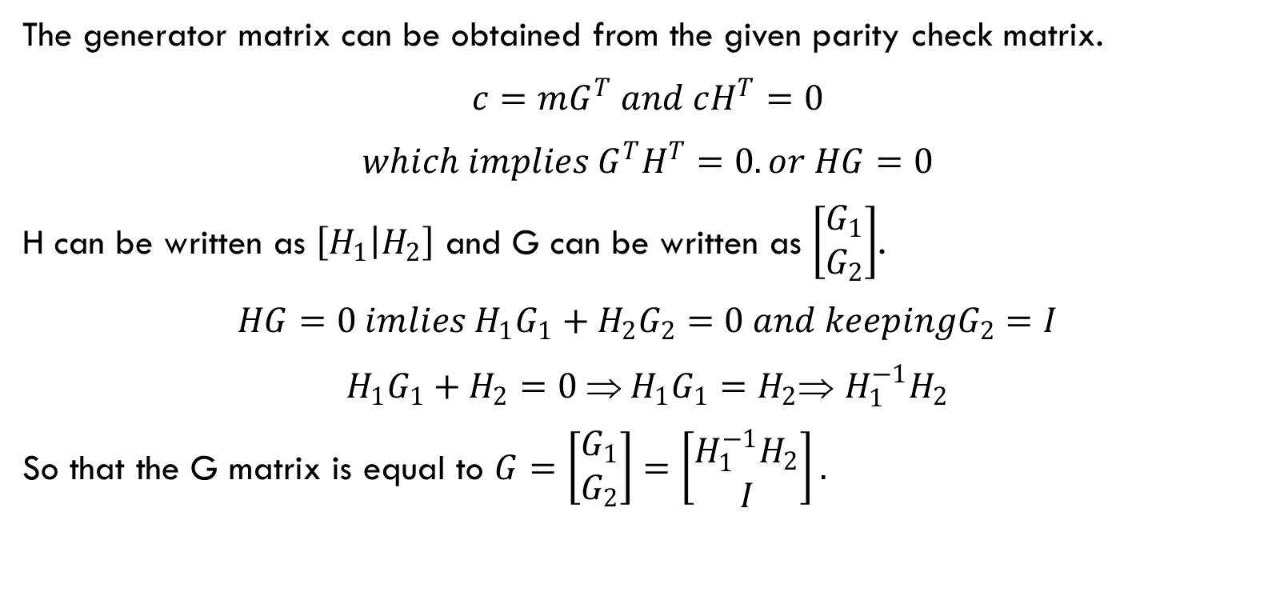
Generator matrix
The generator matrix can be obtained from the given parity check matrix.
$c=mG^{T} and cH^{T}=0$
$which implies G^{T}H^{T}=0. or HG=0$
H can be written as $\left[H_{1} | H_{2}\right]$ and G can be written as $\left[\begin{matrix}G_{1} \\ G_{2}\end{matrix}\right]$.
$HG=0 imlies H_{1}G_{1}+H_{2}G_{2}=0 and keepingG_{2}=I$
$H_{1}G_{1}+H_{2}=0  H_{1}G_{1}=H_{2}$ $H_{1}^{−1}H_{2}$
So that the G matrix is equal to $G=\left[\begin{matrix}G_{1} \\ G_{2}\end{matrix}\right]=\left[\begin{matrix}H_{1}^{−1}H_{2} \\ I\end{matrix}\right].$

Slide 12
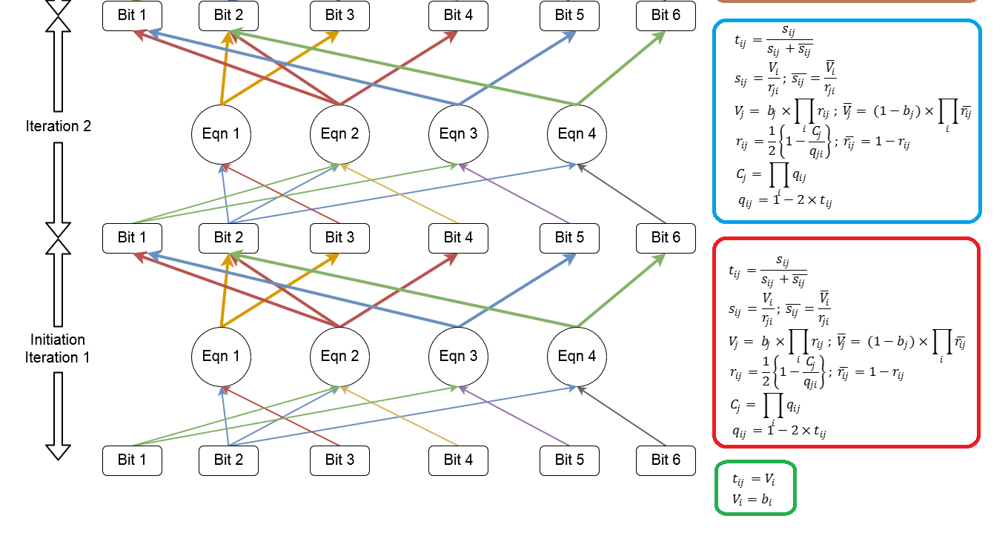
SUM Product algorithm

Slide 13
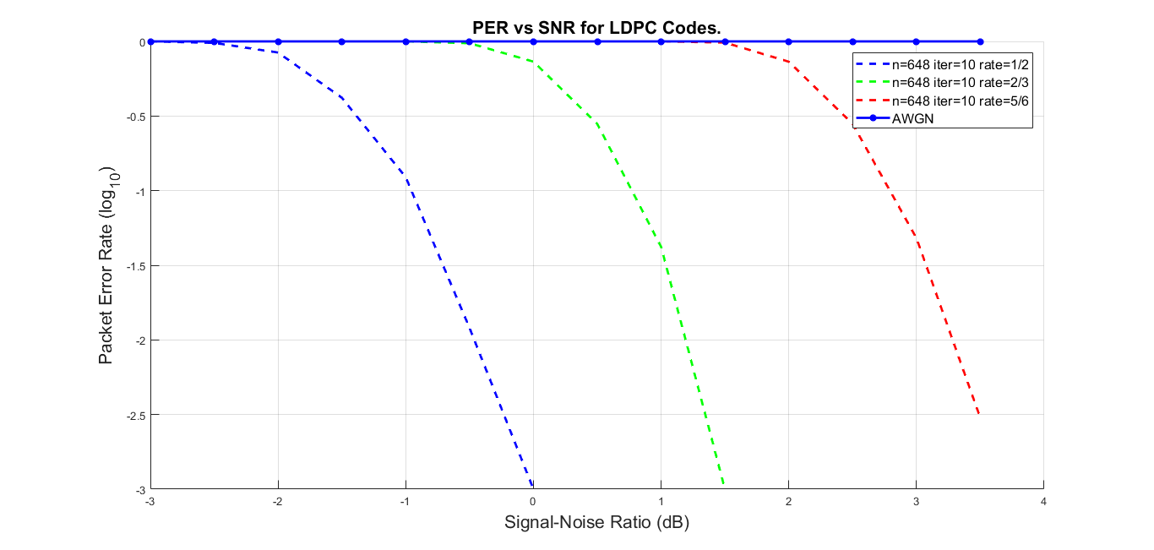
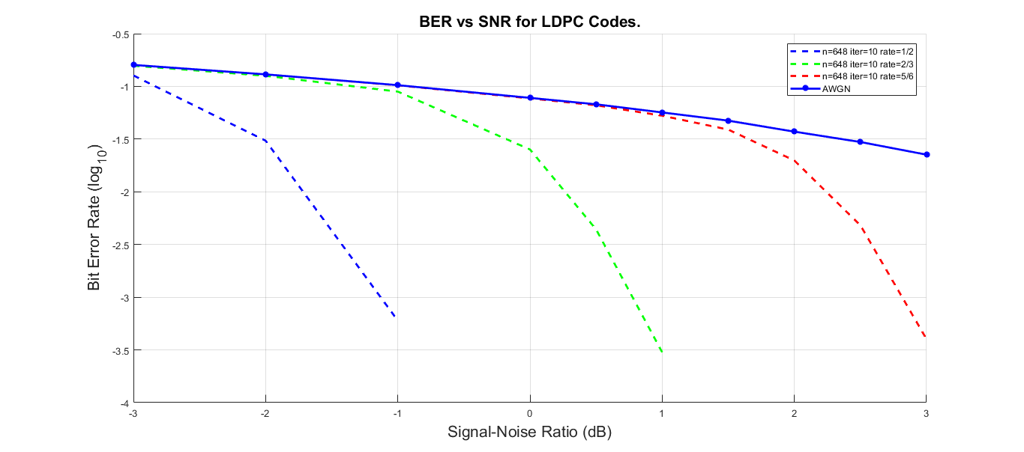
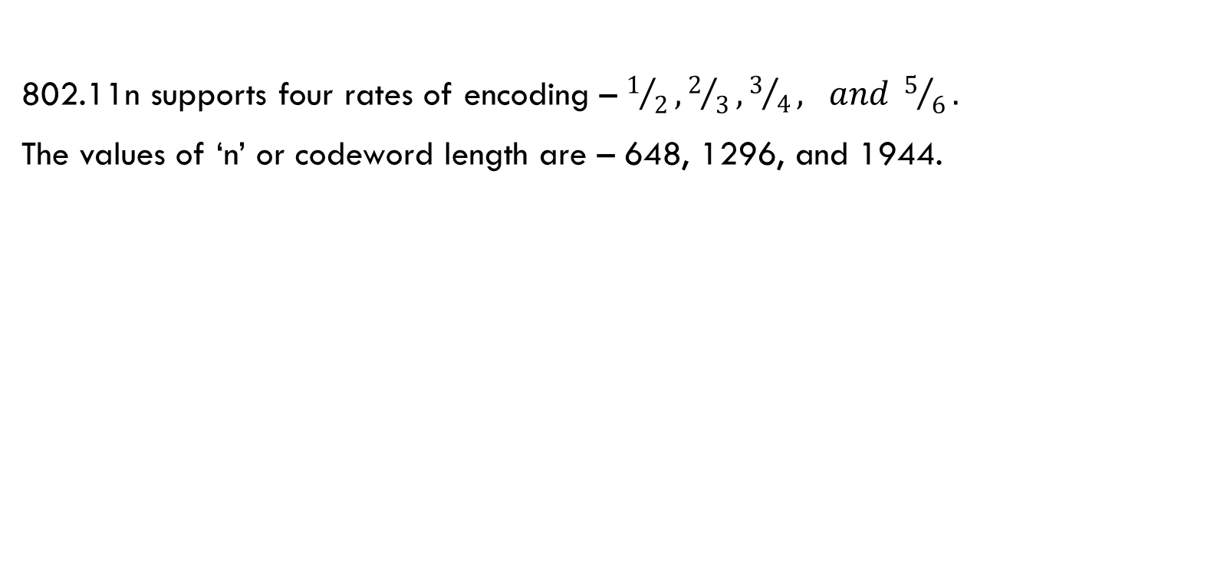
802.11n specified ldpc code
802.11n supports four rates of encoding – $1/2, 2/3, 3/4, and 5/6.$
The values of ‘n’ or codeword length are – 648, 1296, and 1944.

Slide 14
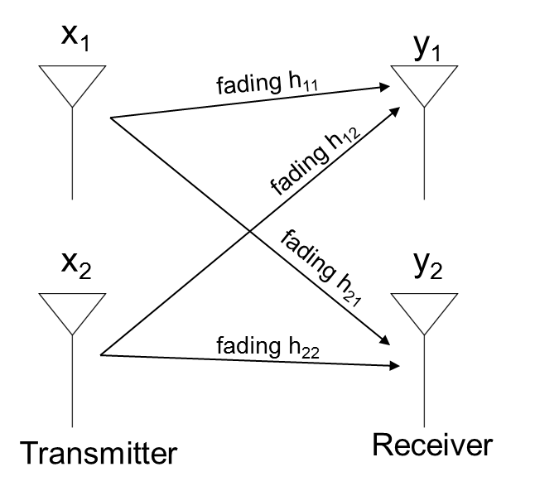
Multiple input multiple output
A MIMO link consists of two or more transmit and receive antenna.
$$y_{1}=h_{11}x_{1}+ h_{12}x_{2}+n_{1} and y_{2}=h_{21}x_{1}+ h_{22}x_{2}+n_{2}$$
Functions of MIMO:
Diversity Coding: In the diversity method a single stream of data is transmitted through multiple antenna.
Spatial Multiplexing: In spatial multiplexing, a high-rate signal is split into multiple lower-rate streams and each stream is transmitted from a different transmit antenna in the same frequency channel.
Fig: Multiple Input Multiple
Output Link

Slide 15
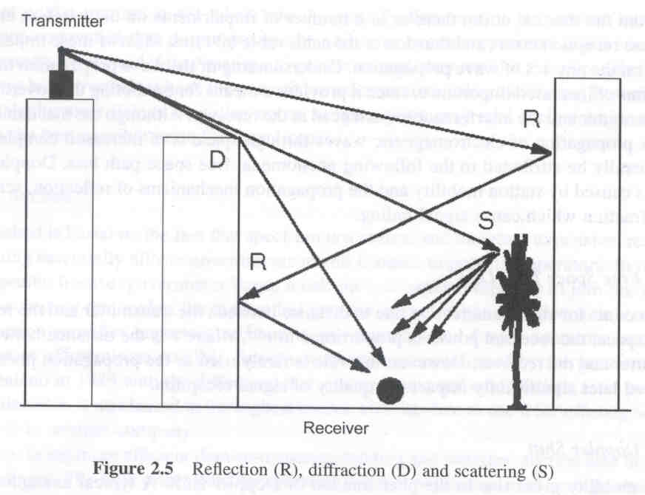
RAYLEIGH FADING CHANNEL
Rayleigh fading is a statistical model for the effect of a propagation environment on a radio signal as in wireless devices
It is viewed as a reasonable model for the effect of heavily built-up urban environments on radio signals.
Using this model, the statistical properties of the channel co-efficient $h_{1}, h_{2}, h_{11}, h_{12}$ etc is determined
$$\left.h\left(t\right)= h_{I}\left(t\right)+jh_{Q}(t\right)$$
In the above equation $h_{I}\left(t\right) and h_{Q}(t)$ are independent random gaussian variable with $variance=0.5$
Fig: Multipath Link

Slide 16
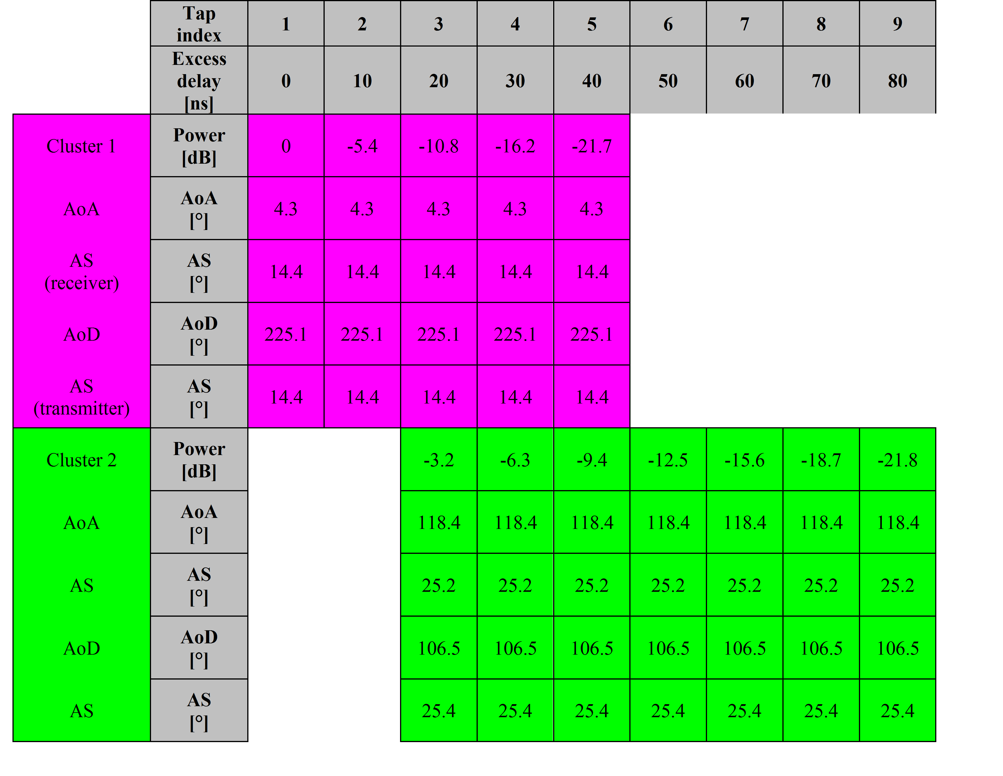
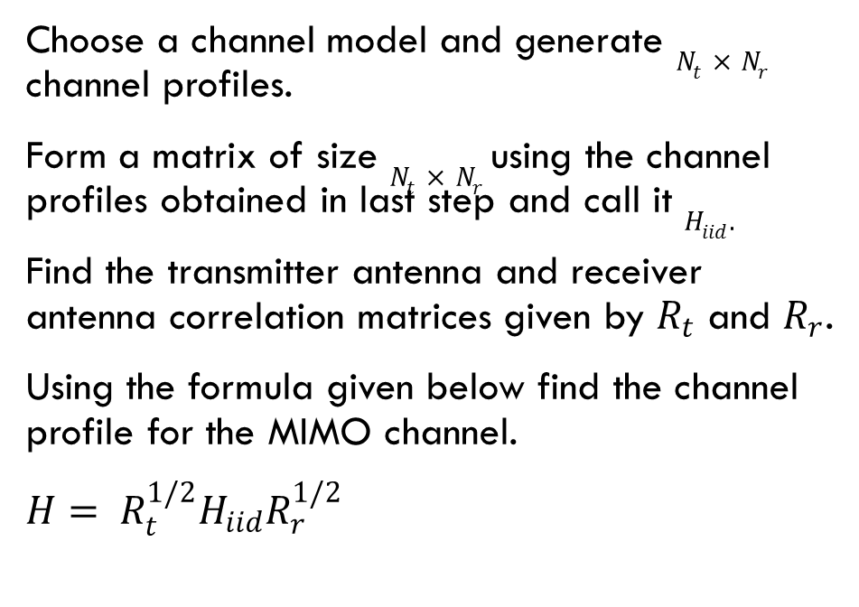
MIMO CHANNEL MODELS
Choose a channel model and generate $N_{t}×N_{r}$ channel profiles.
Form a matrix of size $N_{t}×N_{r}$ using the channel profiles obtained in last step and call it $H_{iid}.$
Find the transmitter antenna and receiver antenna correlation matrices given by $R_{t}$ and $R_{r}$.
Using the formula given below find the channel profile for the MIMO channel.
$H= R_{t}^{1/2}H_{iid}R_{r}^{1/2}$
Fig: Channel Model B

Slide 17
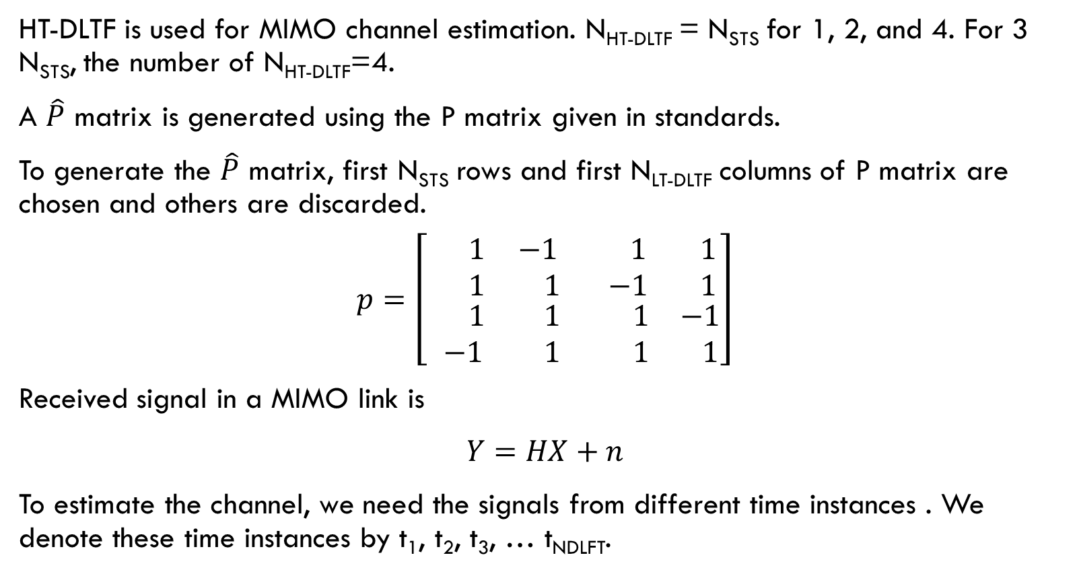
MIMO CHANNEL ESTIMATION
HT-DLTF is used for MIMO channel estimation. N_{HT-DLTF} = N_{STS} for 1, 2, and 4. For 3 N_{STS}, the number of N_{HT-DLTF}=4.
A $\hat{P}$ matrix is generated using the P matrix given in standards.
To generate the $\hat{P}$ matrix, first N_{STS} rows and first N_{LT-DLTF} columns of P matrix are chosen and others are discarded.
$p=\left[\begin{matrix}\begin{matrix} 1 & −1 \\ 1 & 1\end{matrix} & \begin{matrix} 1 & 1 \\ −1 & 1\end{matrix} \\ \begin{matrix} 1 & 1 \\ −1 & 1\end{matrix} & \begin{matrix}1 & −1 \\ 1 & 1\end{matrix}\end{matrix}\right]$
Received signal in a MIMO link is
$Y=HX+n$
To estimate the channel, we need the signals from different time instances . We denote these time instances by t₁, t₂, t₃, … t_{NDLFT}.

Slide 18
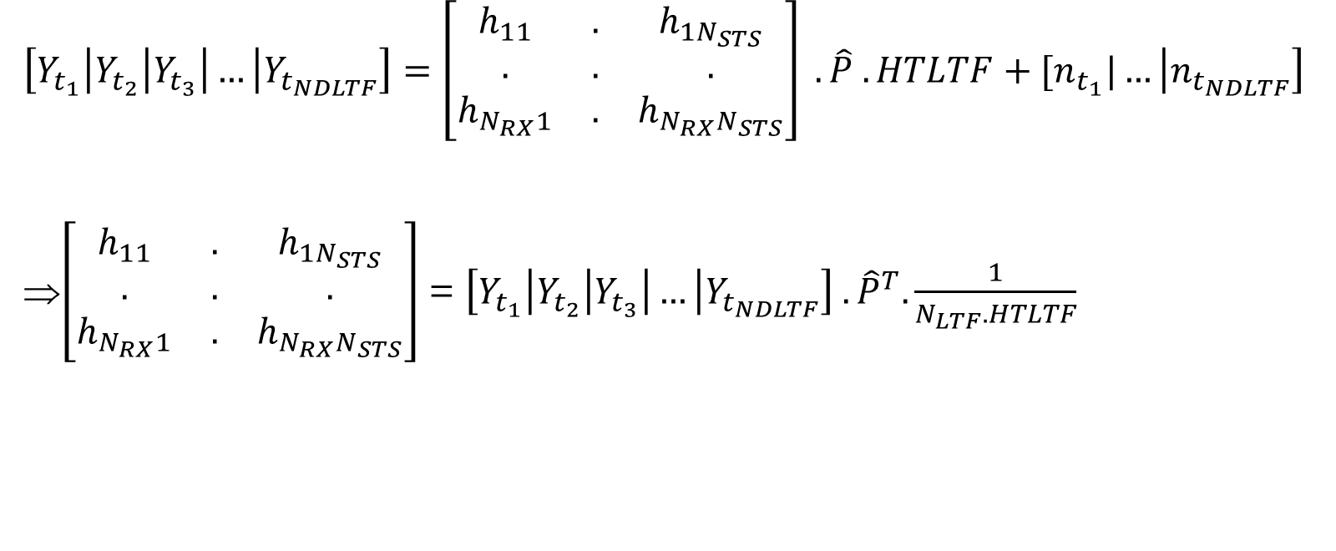
MIMO Channel Estimation
$\left[Y_{t_{1}}\left|Y_{t_{2}}\right|Y_{t_{3}}\right|…\left|Y_{t_{NDLTF}}\right]=\left[\begin{matrix}h_{11} & . & h_{1N_{STS}} \\ . & . & . \\ h_{N_{RX}1} & . & h_{N_{RX}N_{STS}}\end{matrix}\right] . \hat{P} . HTLTF+[n_{t_{1}}|…\left|n_{t_{NDLTF}}\right]$
⇒$\left[\begin{matrix}h_{11} & . & h_{1N_{STS}} \\ . & . & . \\ h_{N_{RX}1} & . & h_{N_{RX}N_{STS}}\end{matrix}\right]$ = $\left[Y_{t_{1}}\left|Y_{t_{2}}\right|Y_{t_{3}}\right|…\left|Y_{t_{NDLTF}}\right] . {\hat{P}}^{T}. \frac{1}{N_{LTF}. HTLTF}$

Slide 19
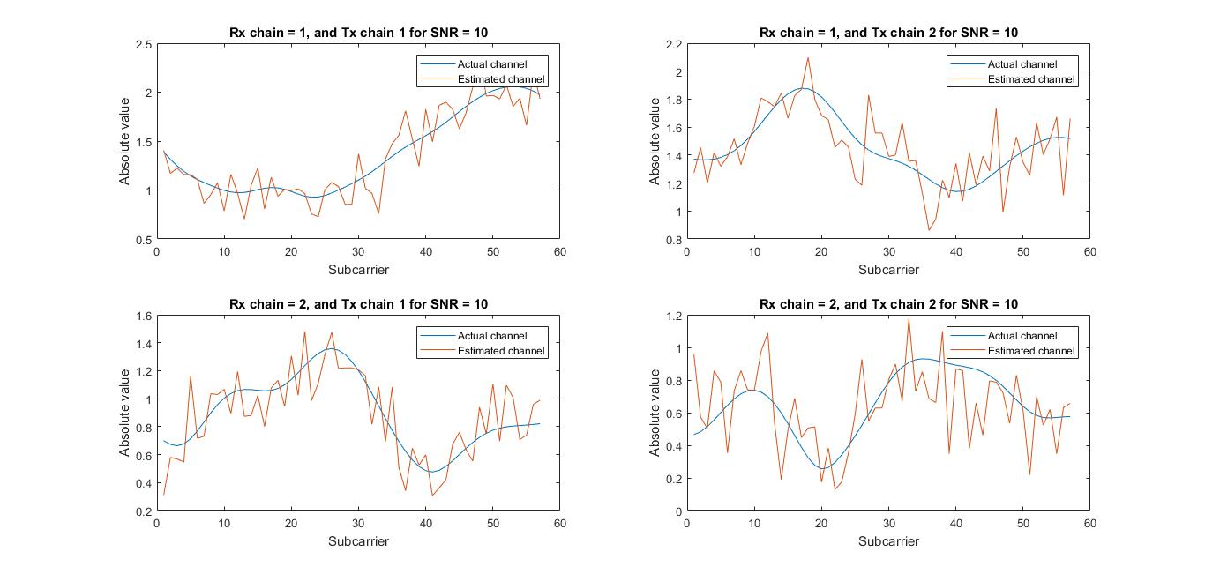
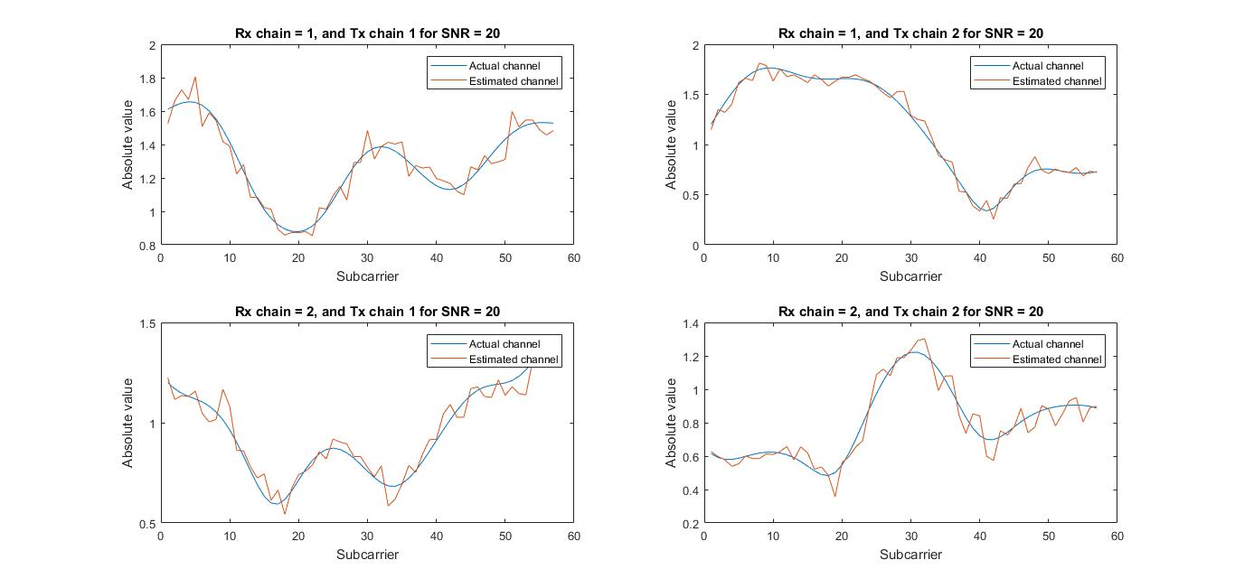
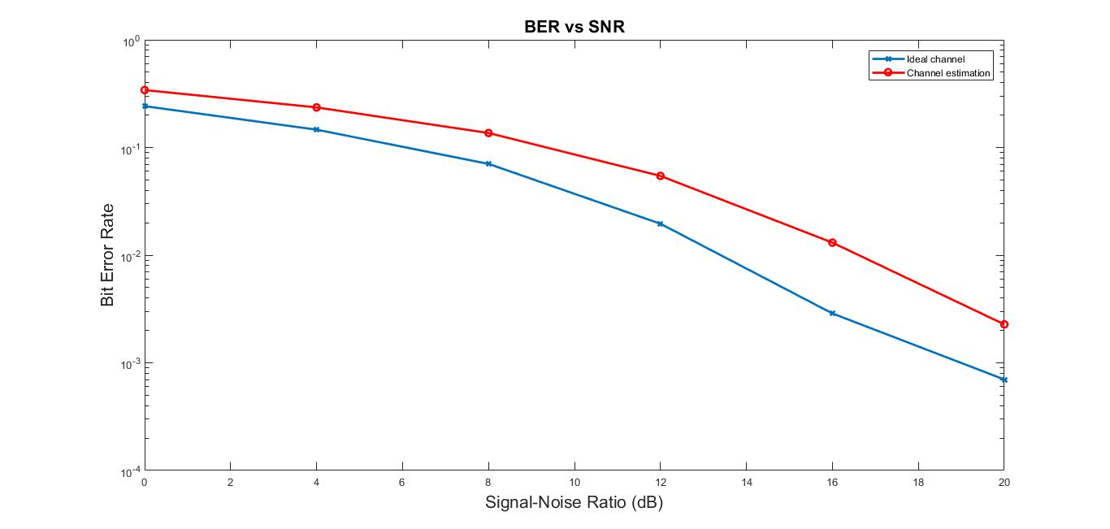
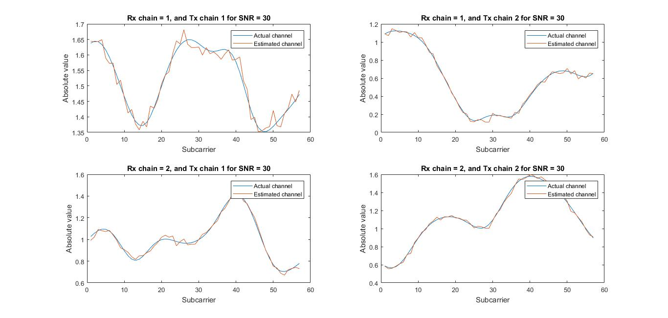
MIMO Channel ESTIMATION

Slide 20
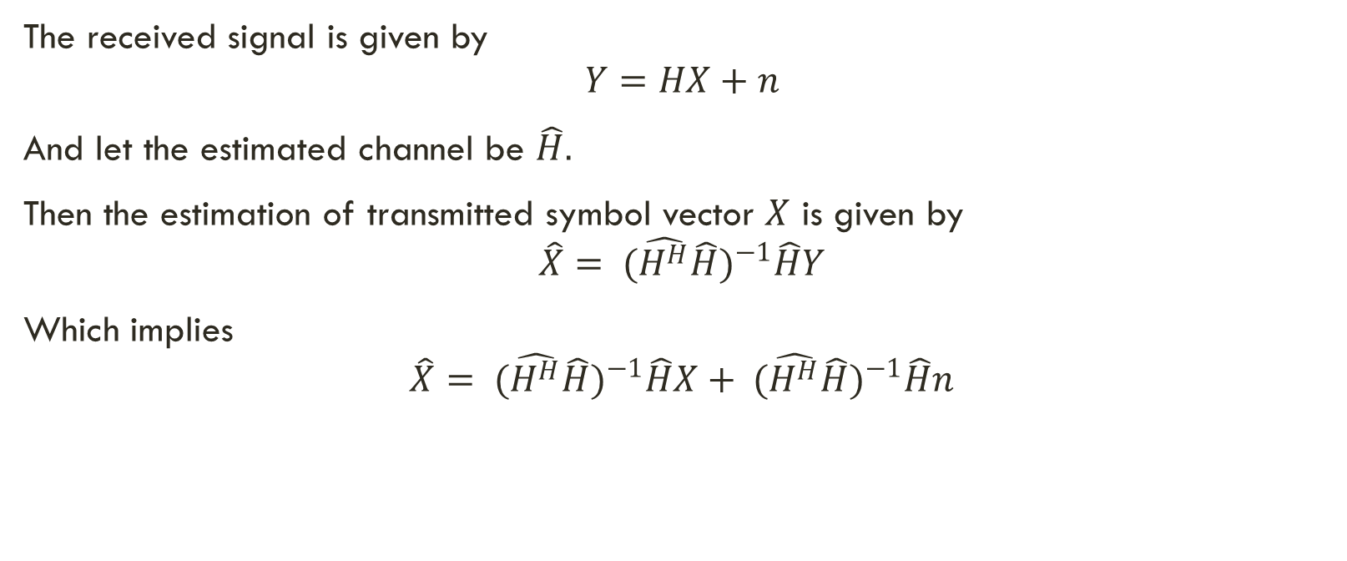
MIMO Channel EQUALISATION
The received signal is given by
$$Y=HX+n$$
And let the estimated channel be $\hat{H}.$
Then the estimation of transmitted symbol vector $X$ is given by
$$\hat{X}= {(\hat{H^{H}}\hat{H})}^{−1}\hat{H}Y$$
Which implies
$$\hat{X}= {(\hat{H^{H}}\hat{H})}^{−1}\hat{H}X+ {(\hat{H^{H}}\hat{H})}^{−1}\hat{H}n$$

Slide 21
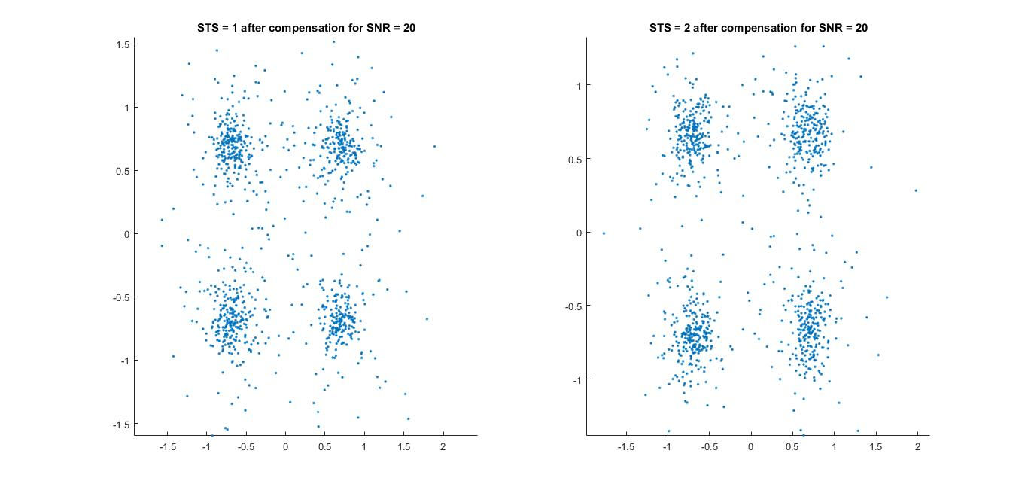
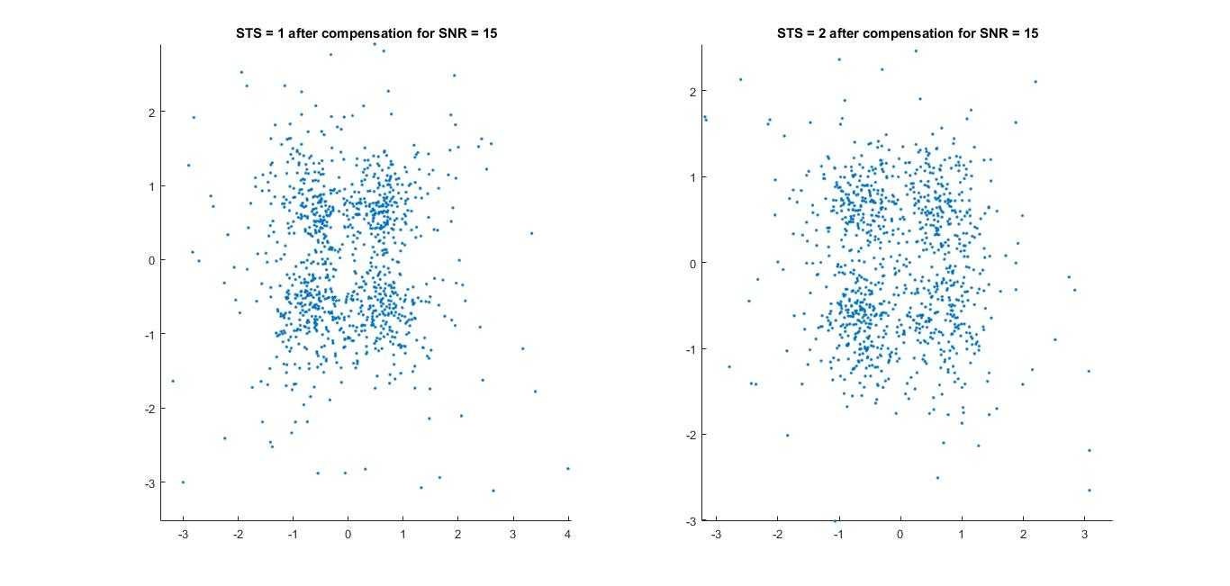
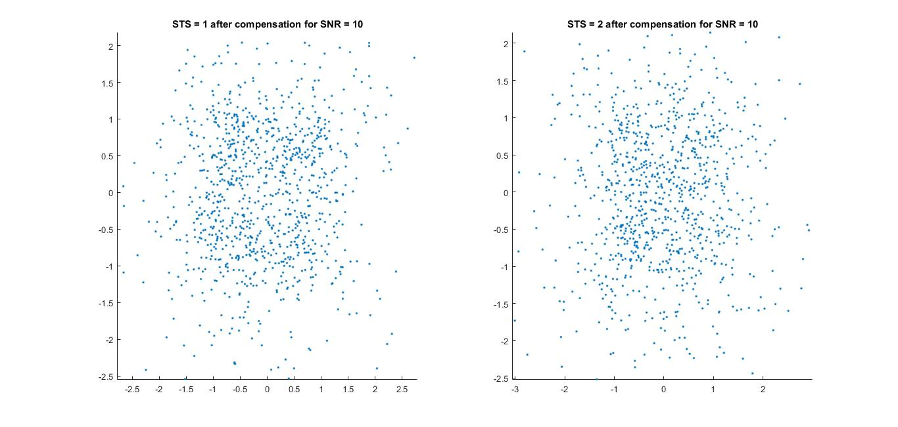
MIMO Channel EQUALISATION

Slide 22
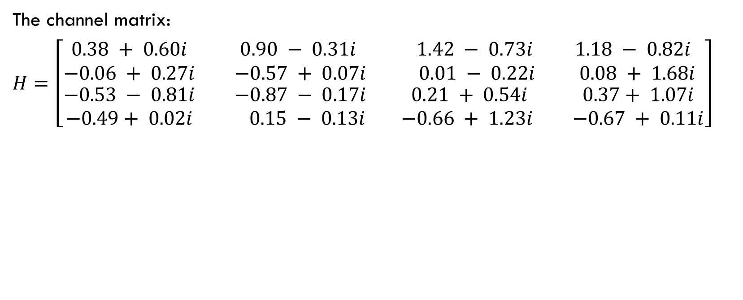
CAPACITY ANALYSIS FOR CODEBOOK
The channel matrix:
$H=\left[\begin{matrix}\begin{matrix}0.38 + 0.60i & 0.90 − 0.31i \\ −0.06 + 0.27i & −0.57 + 0.07i\end{matrix} & \begin{matrix} 1.42 − 0.73i & 1.18 − 0.82i \\ 0.01 − 0.22i & 0.08 + 1.68i\end{matrix} \\ \begin{matrix}−0.53 − 0.81i & −0.87 − 0.17i \\ −0.49+ 0.02i & 0.15 − 0.13i\end{matrix} & \begin{matrix} 0.21 + 0.54i & 0.37+ 1.07i \\ −0.66 + 1.23i & −0.67 + 0.11i\end{matrix}\end{matrix}\right]$
Optimum precoder matrix for various SNRs for the channel matrix:
SNR (in dB) | Channel Capacity | Optimum Layer | Optimum Precoder
0 | 3.7282 | 2 | 6
3 | 5.3683 | 3 | 6
6 | 7.5356 | 3 | 6
9 | 10.0193 | 3 | 6
12 | 12.7427 | 4 | 1
15 | 16.0796 | 4 | 1

Slide 23
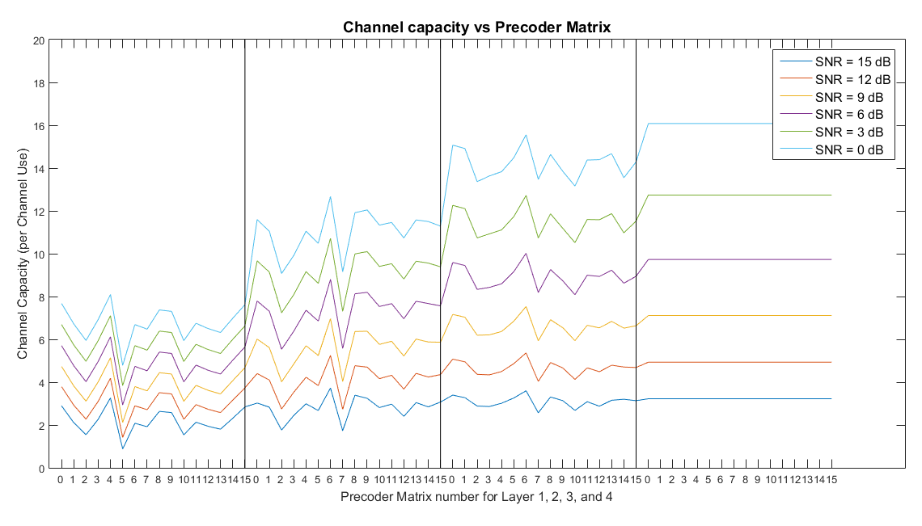
CAPACITY ANALYSIS FOR CODEBOOK

Slide 24
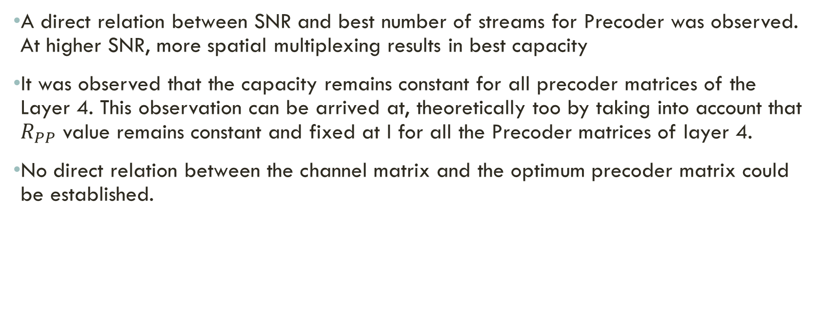
OBSERVATIONS
A direct relation between SNR and best number of streams for Precoder was observed. At higher SNR, more spatial multiplexing results in best capacity
It was observed that the capacity remains constant for all precoder matrices of the Layer 4. This observation can be arrived at, theoretically too by taking into account that $R_{PP}$ value remains constant and fixed at I for all the Precoder matrices of layer 4.
No direct relation between the channel matrix and the optimum precoder matrix could be established.

Slide 25
Packet detection
Transmission and reception are done with an assumption that the synchronization at the receiver is perfect.
For a higher data rate, the number of subcarriers increase which in turn reduce the subcarrier spacing for the same available BW.
WLAN systems typically have to use so called "single shot" synchronization.
Packet detection can be described as a binary hypothesis test.
A better packet detector has lesser Probability of false alarms thereby saving the receiver's energy.
Auto-correlation and Cross-correlation based Packet Detection perform better than RSE based Packet Detection, the algorithm required for RSE based detection is lightweight.

Slide 26
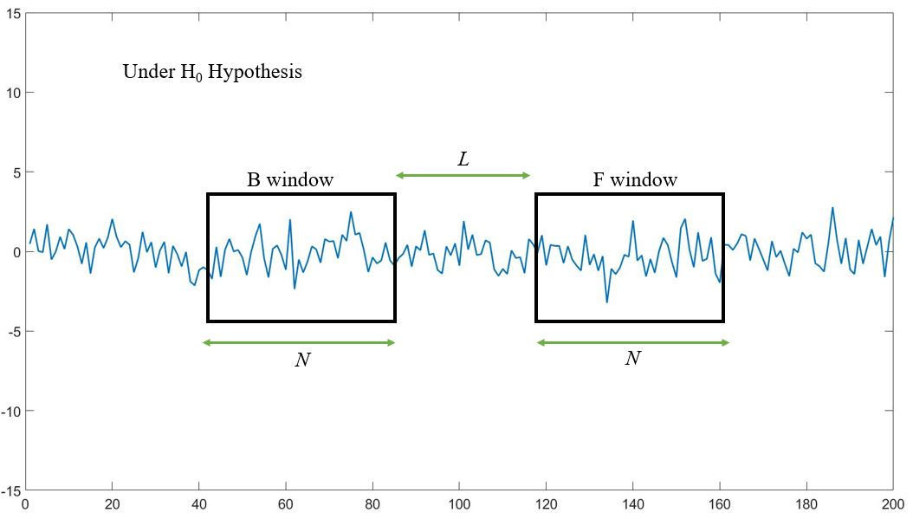
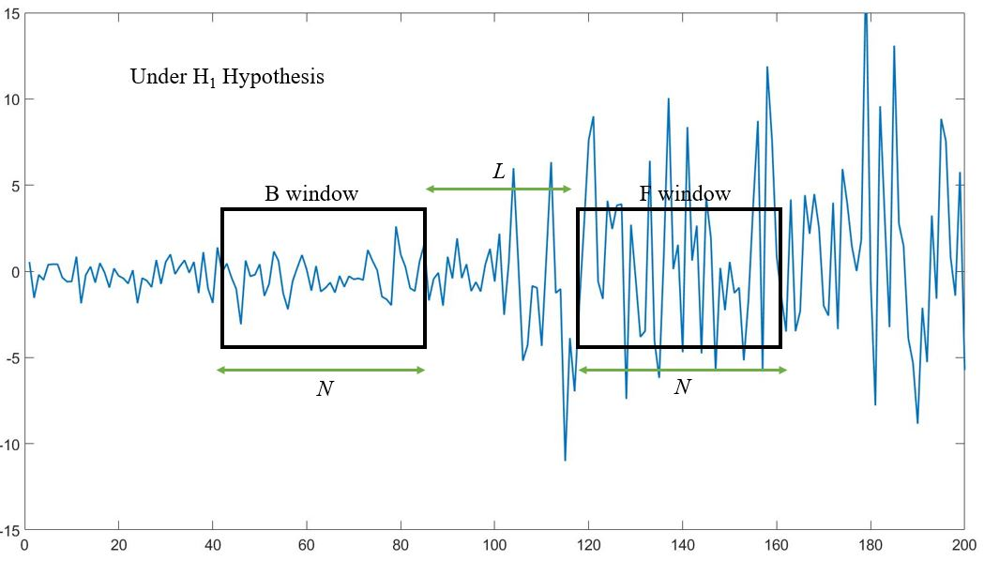
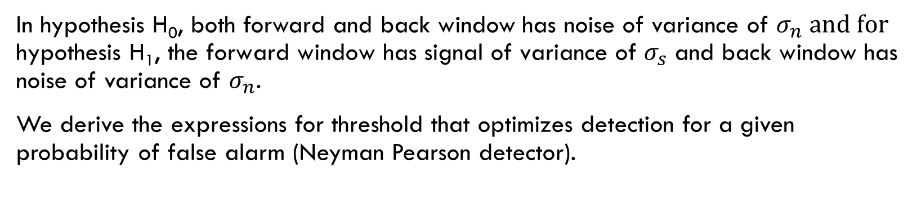
DOUBLE SLIDING WINDOW
In hypothesis H₀, both forward and back window has noise of variance of $σ_{n} \text{and} \text{for} \text{hypothesis} \text{H}\text{1}\text{, }\text{the} \text{forward} \text{window} \text{has} \text{signal} \text{of} \text{variance} \text{of} σ_{s}$ and back window has noise of variance of $σ_{n}$.
We derive the expressions for threshold that optimizes detection for a given probability of false alarm (Neyman Pearson detector).

Slide 27
Algorithm for packet detection
The algorithm presented here is exclusively for sequential computers.
The low-level interface nature of it makes it very easy to be converted into algorithm for parallel computers or even hardware.
/* Variable description and initialisation
p <- Pointer to input buffer
gap_size <- Gap between two windows
win_size <- Window size
N <- length of input buffer
Sigma[0:N-1] <- An array of size N that stores energy of a window
past[0:win_size-1] <- Array that stores data from last buffer.
Output[0:N-1] <- Pointer to output buffer.
*/

Slide 28
Algorithm for packet detection
If (first_loop)
Sigma(win_size-1) = sum(p[0:win_size-1]);
Else
For i=0 to win_size
Sigma(i) = Sigma[(i-1)%N] + p[i] – past[i];
output = sigma[i]/sigma[(i-gap_size-win_size)%N];
For i= win_size:N-1
Sigma(i) = Sigma(i-1) + p(i) – p(i-win_size);
output = sigma[i]/sigma[(i-gap_size-win_size)%N];
copy p[N-win_size:N-1] into past[0:win_size];

Slide 29
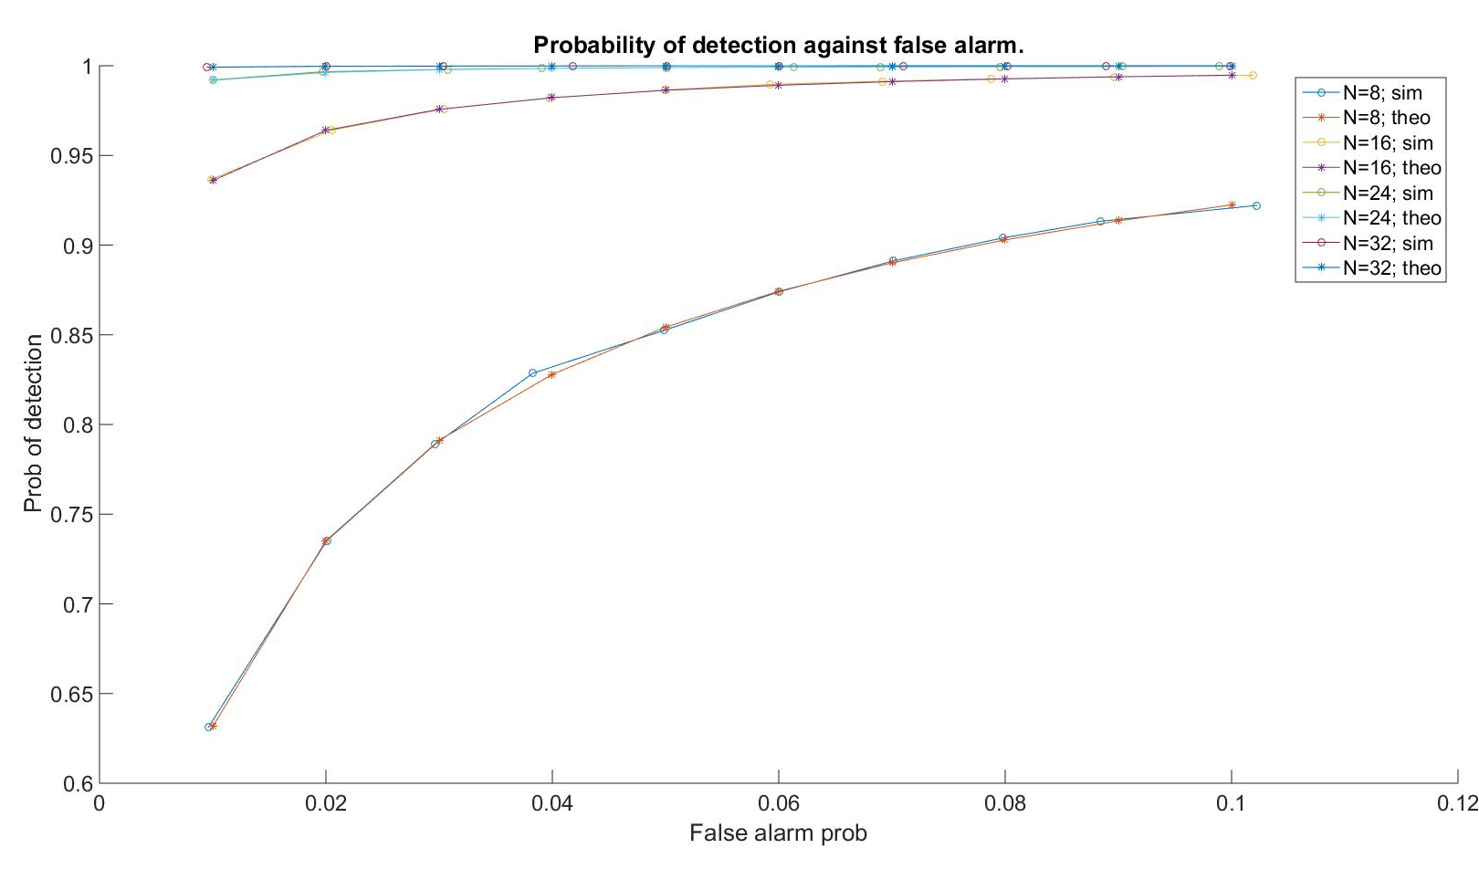
SIMULATION OF packet detection

Slide 30
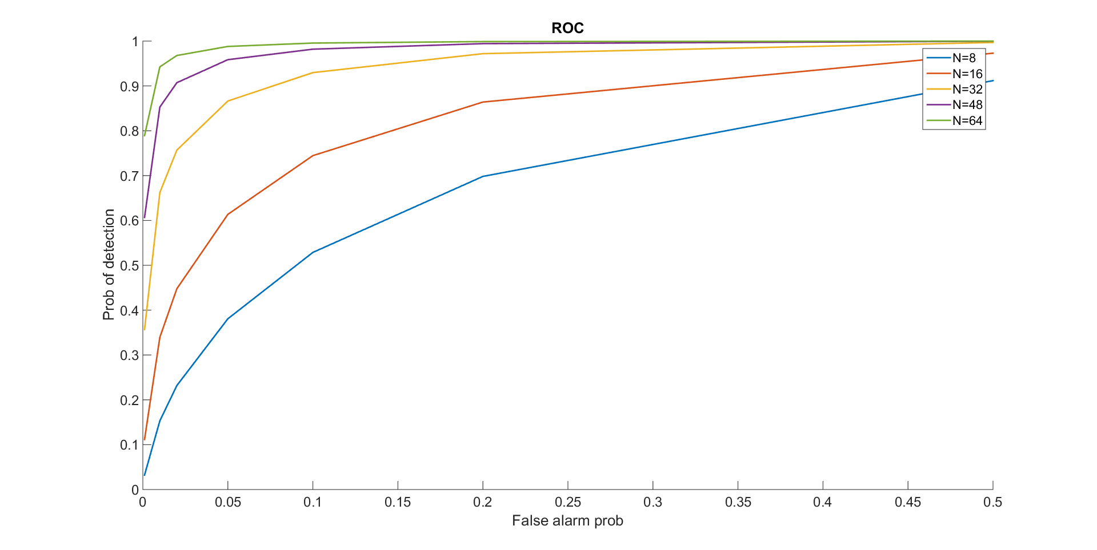
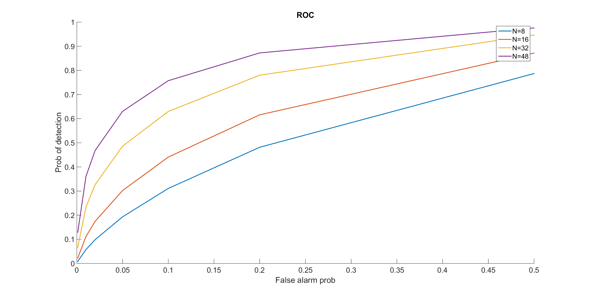
SIMULATION OF packet detection
ROC for SNR = -3dB.
ROC for SNR = 0dB.

Slide 31
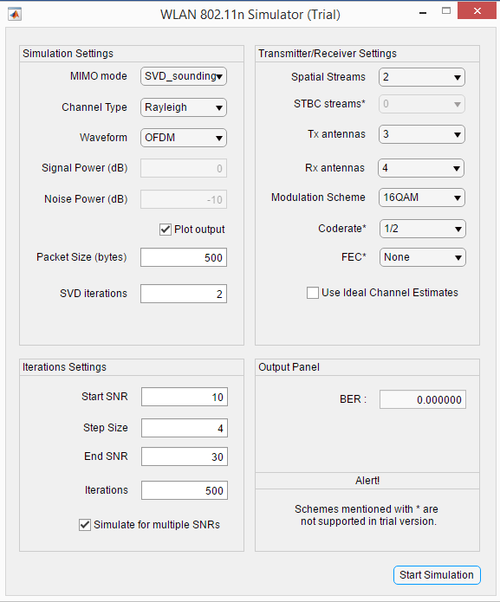
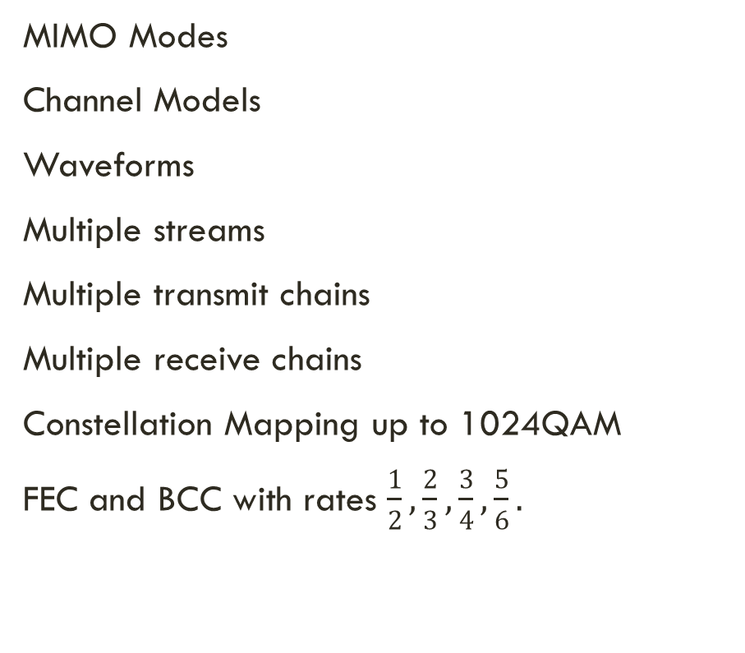
SIMULATOR
MIMO Modes
Channel Models
Waveforms
Multiple streams
Multiple transmit chains
Multiple receive chains
Constellation Mapping up to 1024QAM
FEC and BCC with rates $\frac{1}{2},\frac{2}{3},\frac{3}{4},\frac{5}{6}.$

Slide 32
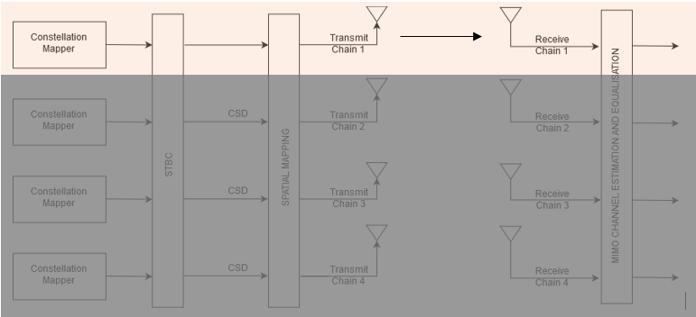
MIMO MODES - SISO

Slide 33
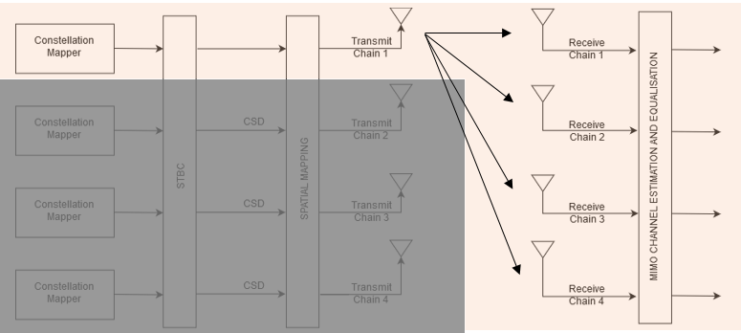
MIMO MODES - MRC

Slide 34
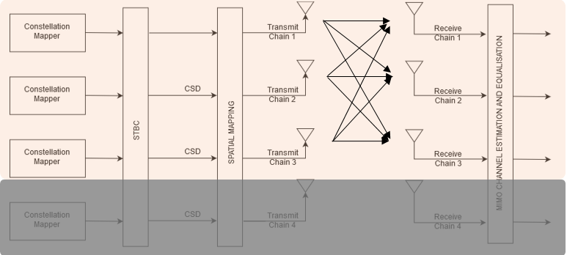
MIMO MODES – V BLAST

Slide 35
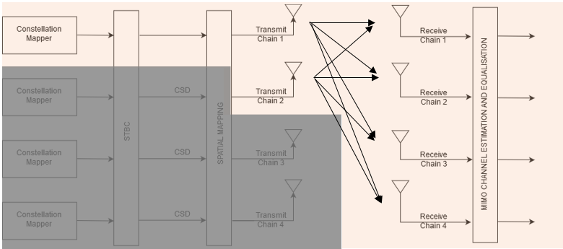
MIMO MODES – CODEBOOK

Slide 36
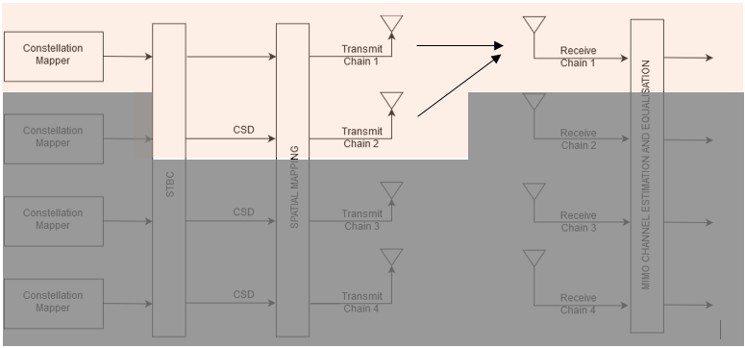
MIMO MODES – STBC

Slide 37
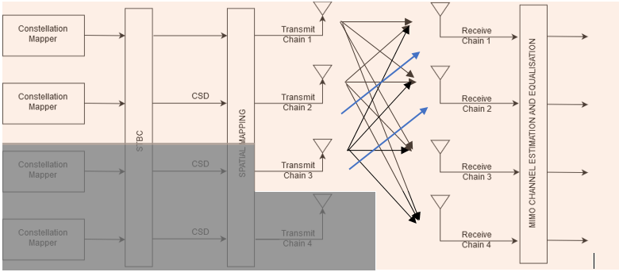
MIMO MODES – SVD

Slide 38
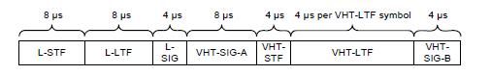
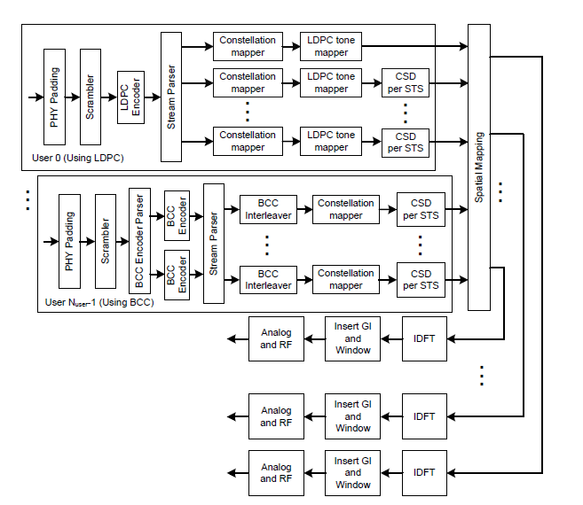
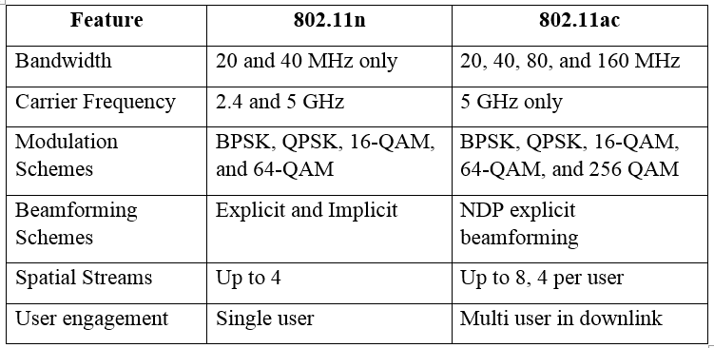
802.11ac

Slide 39
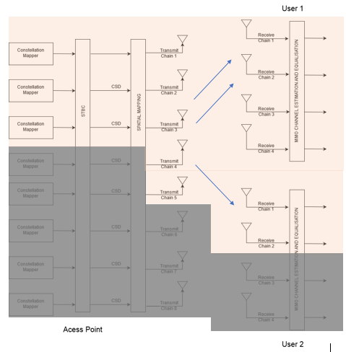
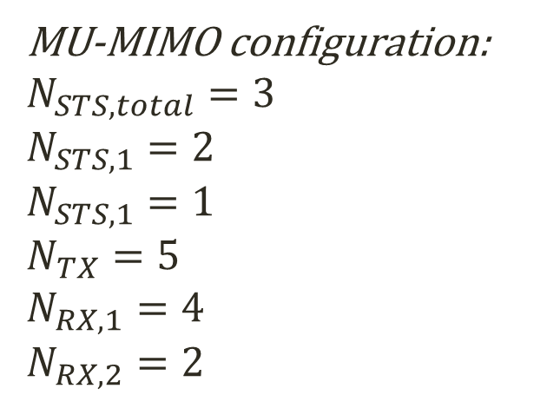
802.11ac
MU-MIMO configuration:
$$N_{STS, total}=3$$
$$N_{STS, 1}=2$$
$$N_{STS, 1}=1$$
$$N_{TX}=5$$
$$N_{RX, 1}=4$$
$$N_{RX, 2}=2$$

Slide 40
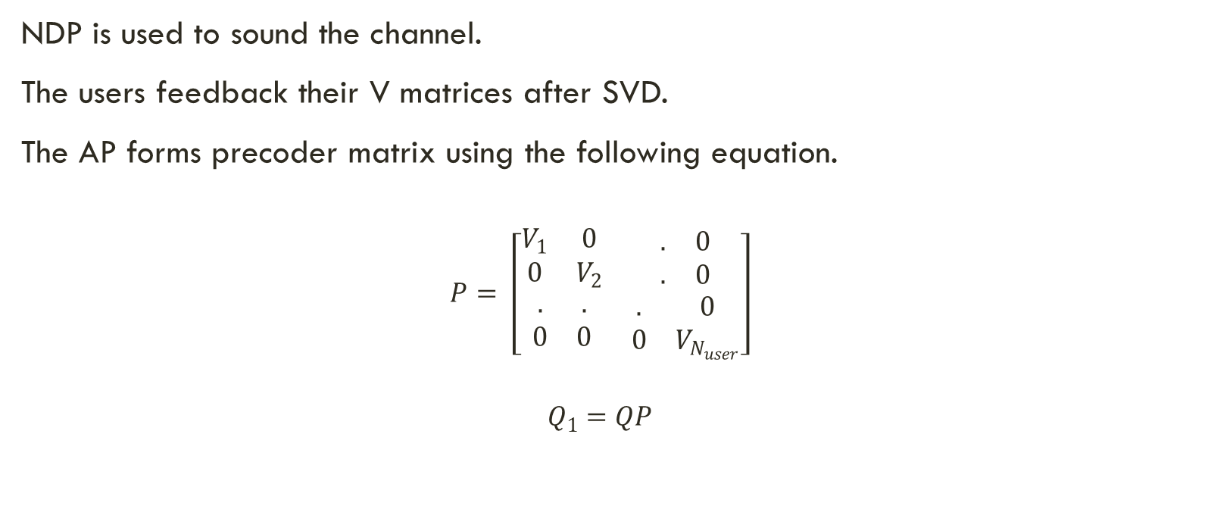
MU MIMO - SVD
NDP is used to sound the channel.
The users feedback their V matrices after SVD.
The AP forms precoder matrix using the following equation.
$$P= \left[\begin{matrix}\begin{matrix}V_{1} & 0 \\ 0 & V_{2}\end{matrix} & \begin{matrix}. & 0 \\ . & 0\end{matrix} \\ \begin{matrix}. & . \\ 0 & 0\end{matrix} & \begin{matrix}. & 0 \\ 0 & V_{N_{user}}\end{matrix}\end{matrix}\right]$$
$$Q_{1}=QP$$

Slide 41
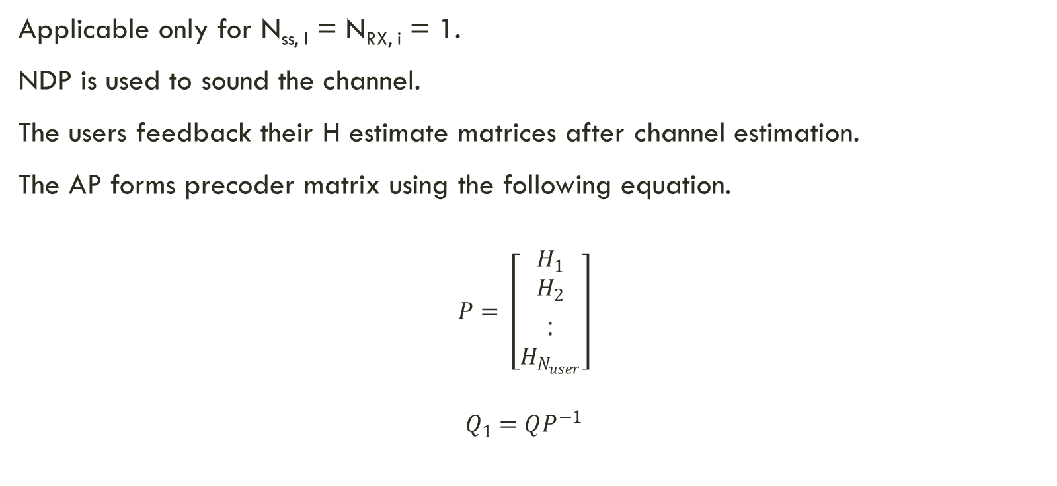
MU MIMO – CHANNEL INVERSION
Applicable only for N_{ss, I} = N_{RX, i} = 1.
NDP is used to sound the channel.
The users feedback their H estimate matrices after channel estimation.
The AP forms precoder matrix using the following equation.
$$P= \left[\begin{matrix}\begin{matrix}H_{1} \\ H_{2} \\ .\end{matrix} \\ . \\ H_{N_{user}}\end{matrix}\right]$$
$$Q_{1}=QP^{−1}$$

Slide 42

MU-MIMO
SNR vs BER curve using QPSK for MU-MIMO system with two users.

Slide 43

Massive mimo
SNR vs BER curve using 16-QAM for massive-MIMO system.

Slide 44


802.11n Implementation on NI-USRP

Slide 45
References
1. IEEE P802.11n, Part 11: Wireless LAN Medium Access Control (MAC) and Physical Layer (PHY) Specifications: Enhancements for Higher Throughput. 2009
2. Eldad Perahia & Robert Stacey, “Next Generation Wireless LANs. Throughput, Robustness and Reliability in 802.11n”, Cambridge University Press, 2008.
3. Wireless LAN Medium Access Control (MAC) and Physical Layer (PHY) Specifications: Enhancements for Very High Throughput for Operation in Bands below 6GHz, IEEE P802.11ac/D1.0 Std., Jan. 2011
4. R. G. Gallager, “Low-density parity-check code,” IRE Trans. Inform. Theory, vol. IT-8, pp. 21-28, Jan. 1962.
5. S. M. Alamouti, “A Simple Transmit Diversity Technique for Wireless Communications”, IEEE JSAC, vol. 16, no. 8, Oct. 1998, pp.1451-58
6. A.A.M. Saleh and R.A. Valenzuela, “A statistical model for indoor multipath propagation,” IEEE J. Select. Areas Commun., vol. 5, 1987, pp. 128-137.
7. J. Heiskala & J. Terry, “OFDM Wireless LANs: A Theoretical and Practical Guide”, 2nd ed. Sams Publishing, July 2001.

Slide 46
References
8. M. I. Rahman, Suvra Sekhar Das, Frank H.P Fitzek, “OFDM Based WLAN Systems", Technical Report R-04-1002; v1.2, ISBN 87-90834-43-7, ISSN 0908-1224, Aalborg University, Denmark , February 2005.
9. T. Schmidl and D. Cox, “Robust frequency and timing synchronization for OFDM," IEEE Trans. Commun., vol. 45, pp. 1613{1621, Dec. 997.
10. Steven M. Kay, “Fundamentals of Statistical Signal Processing”, Volume II, Indian Edition, Pearson Publications.
11. Joshi Shailesh A, 14EE10023,”WLAN 802.11 Frame Detector Design”, Electrical Engineering Department, Work done during the 8th semester B.Tech project in the spring semester 2018 under the guidance of Prof. Suvra Sekhar Das.
12. White Paper: LTE Release 12 “LTE Transmission Modes and Beamforming”
13. G. J. Foschini, “Layered space-time architecture for wireless communication in a fading environment when using multi-element antennas,” Bell labs technical journal, vol. 1, no. 2, pp. 41–59, 1996.

Slide 47
THANK YOU
ABHINAV KUMAR VERMA
14EC34002
DEPARTMENT OF ELECTRONICS AND ELECTRICAL COMMUNCIATIONS
INDIAN INSTITUTE OF TECHNOLOGY, KHARAGPUR

